Slide 1



System Level Programming
Unit 14 Exception and Process/Thread
李靓 (Li Jing) lijing712@scu.edu.cn
School of Computer Science / Software Engineering

Slide 2
Exception and Process/Thread
14.0 Flow of control
14.1 Exception
14.2 Process and Thread
14.3 Windows Process and Thread

Slide 3
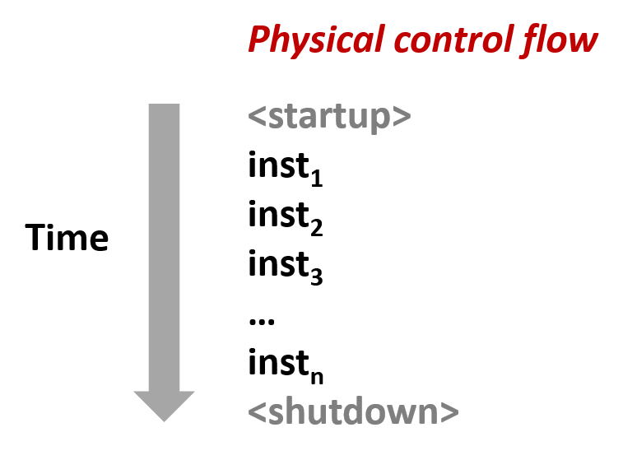
14.0 Flow of Control
The processor reads and executes instruction sequences

Slide 4
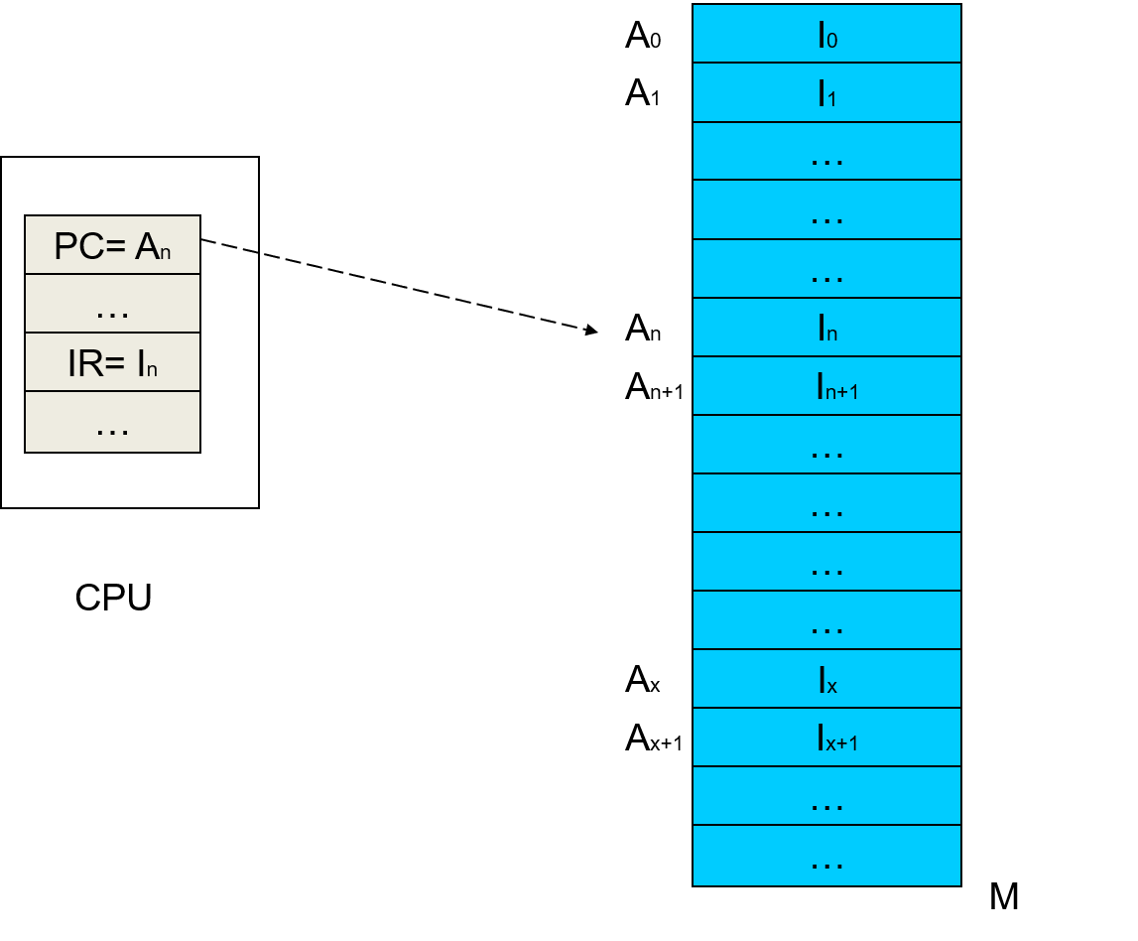
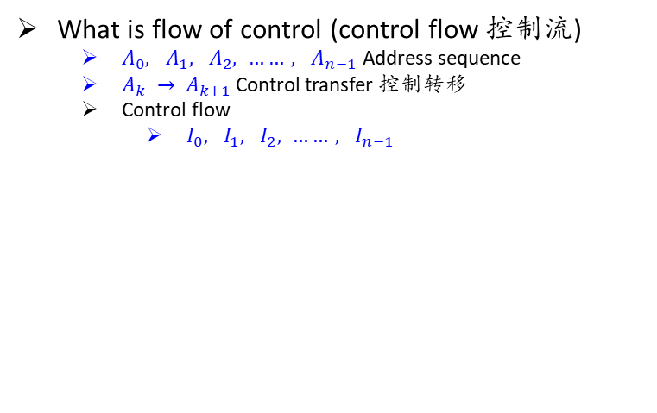
14.0 Flow of Control
What is flow of control (control flow 控制流)
$A_{0}, A_{1}, A_{2}, ……, A_{n−1}$ Address sequence
$A_{k} → A_{k+1}$ Control transfer 控制转移
Control flow
$I_{0}, I_{1}, I_{2}, ……, I_{n−1}$

Slide 5
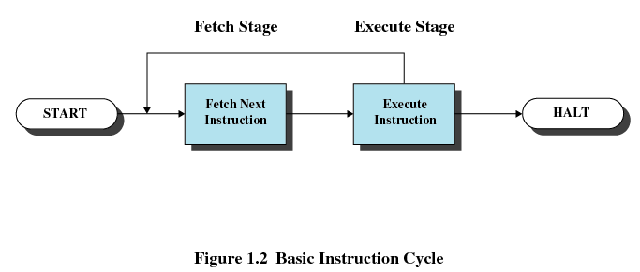
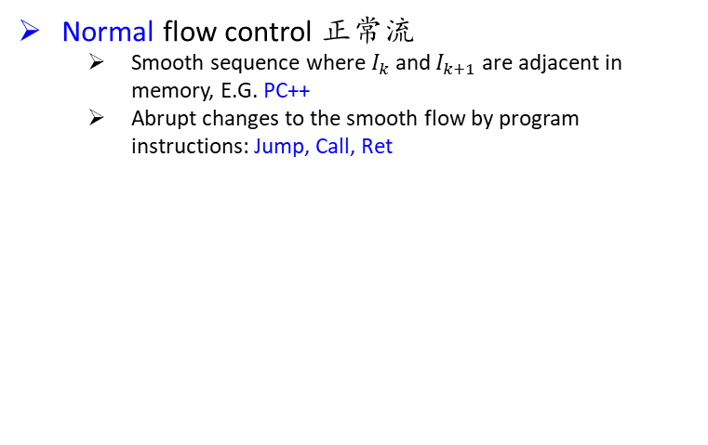
14.0 Flow of Control
Normal flow control 正常流
Smooth sequence where $I_{k}$ and $I_{k+1}$are adjacent in memory, E.G. PC++
Abrupt changes to the smooth flow by program instructions: Jump, Call, Ret

Slide 6
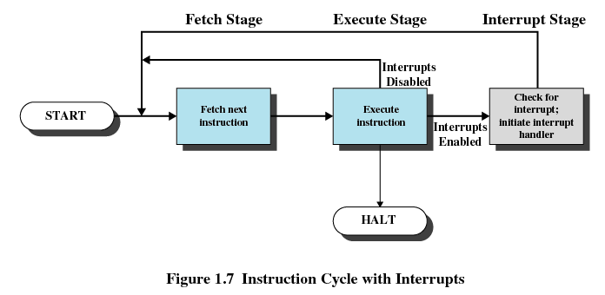
14.0 Flow of Control
Exception flow control 异常流
Abrupt control transfers to react to changes in system state
?

Slide 7
Exception and Process/Thread
14.0 Flow of control
14.1 Exception
14.2 Process and Thread
14.3 Windows Process and Thread

Slide 8
14.1 Exception
14.1.1 Exception introduction
14.1.2 Exception in detail
14.1.3 Exception summary
14.1.4 Exception types
14.1.5 Exception in IA32/x86

Slide 9
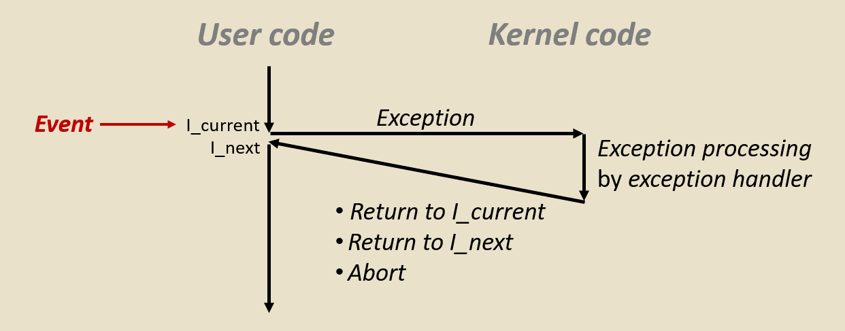
14.1.1 Exception introduction
An exception is an abrupt change in the control flow in response to some change in the processor’s state
Hardware and software cooperation
Hardware dependent

Slide 10
14.1.1 Exception introduction
Exception control flow occurs on different levels
Hardware level
Hardware timer interrupt (PIT)
OS level
Context switching
Application level
setjmp(), longjmp()

Slide 11
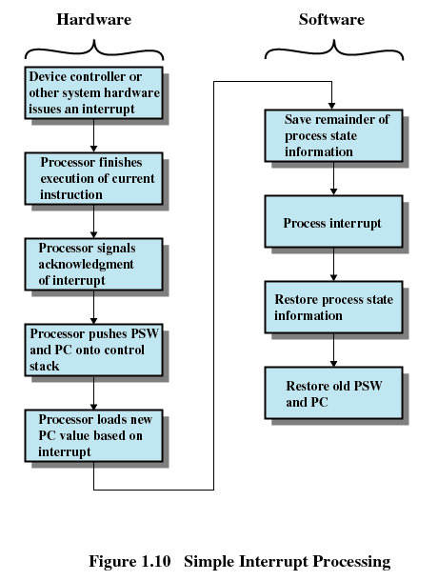
14.1.1 Exception introduction
Hardware and software cooperation on exception handling

Slide 12
14.1 Exception
14.1.1 Exception introduction
14.1.2 Exception in detail
14.1.3 Exception summary
14.1.4 Exception types
14.1.5 Exception in IA32/x86

Slide 13
14.1.2 Exception in detail
Where from?

Slide 14
14.1.2 Exception in detail
How to deal with it?
Exception handler / Interruption Service Routine (ISR)中断服务程序

Slide 15
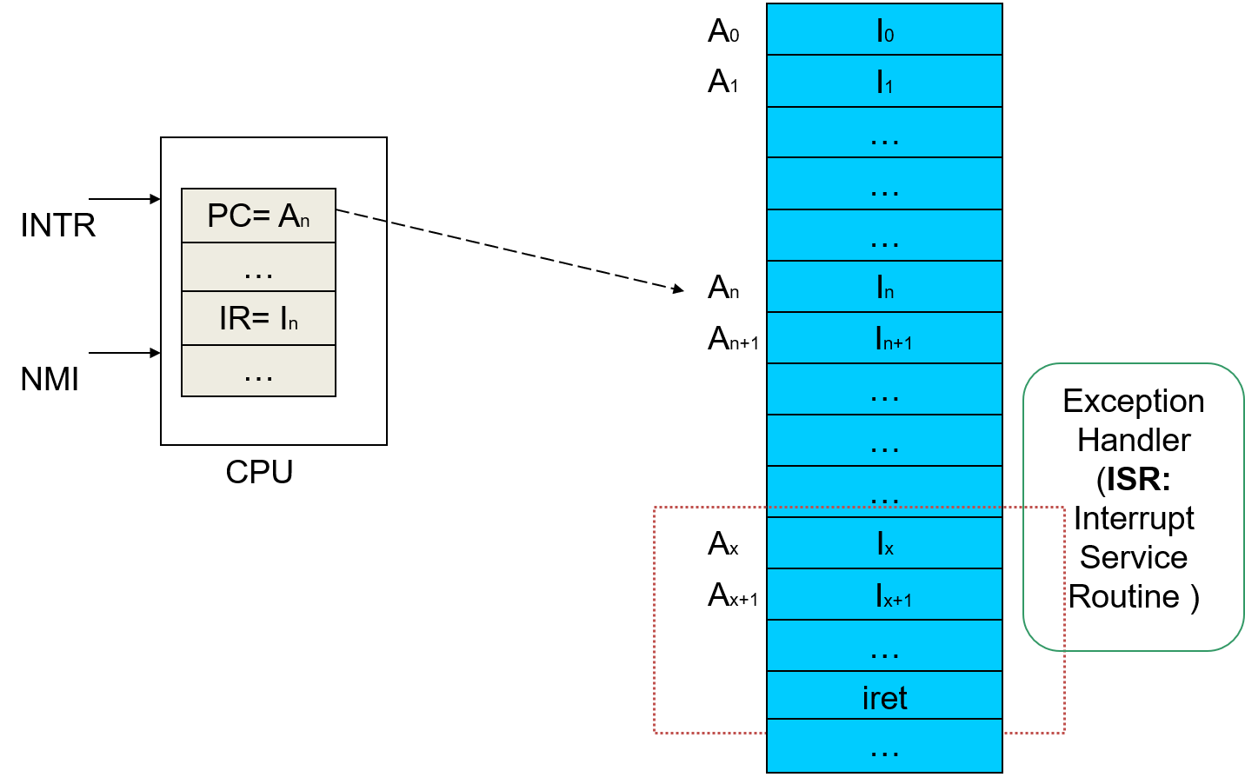
14.1.1 Exception introduction
How to deal with it?

Slide 16
14.1.2 Exception in detail
How to locate the corresponding exception handler/ISR?

Slide 17
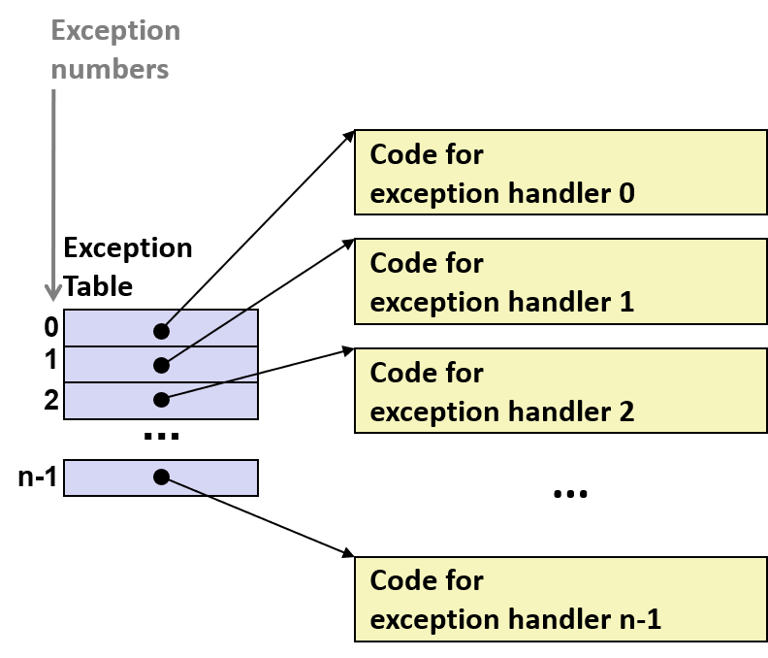
14.1.2 Exception in detail
How to locate the corresponding exception handler/ISR?
Exception number [Page fault 14]
Exception table [initialized at boot time]

Slide 18
14.1.2 Exception in detail
How to locate the corresponding exception handler/ISR?
ETR [Exception Table Base Register]

Slide 19
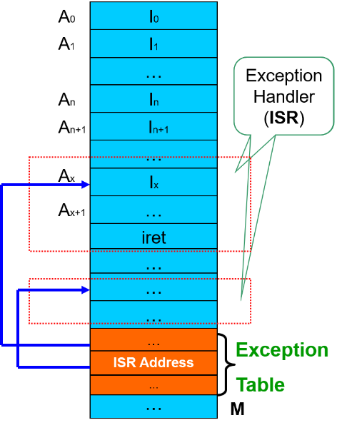
14.1.2 Exception in detail
How to locate the corresponding exception handler/ISR?
Exceptions are numbered
Table items are filled
Exception table
Exception ID
The corresponding ISR address

Slide 20
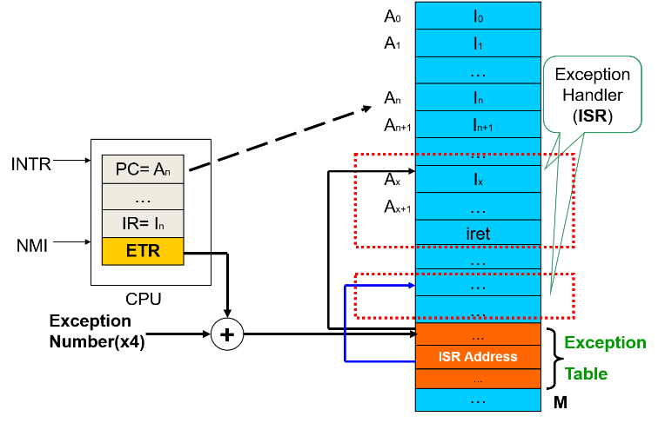
14.1.2 Exception in detail
How to locate the corresponding exception handler/ISR?
Exception X happens, generating the address of an exception handler

Slide 21
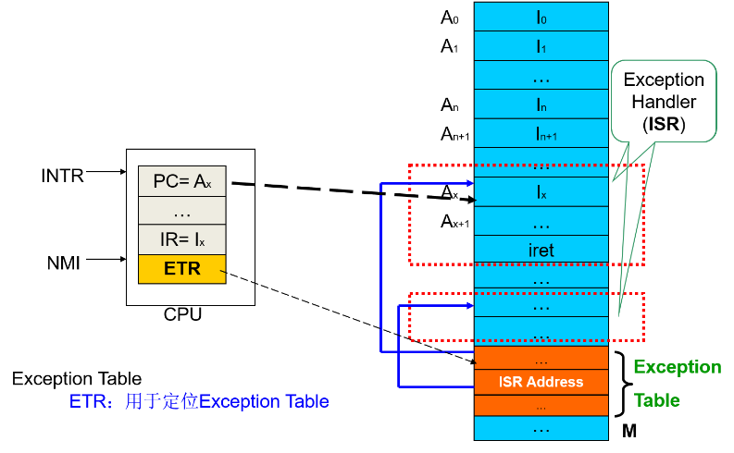
14.1.2 Exception in detail
How to locate the corresponding exception handler/ISR?
Load the instruction of exception handler

Slide 22
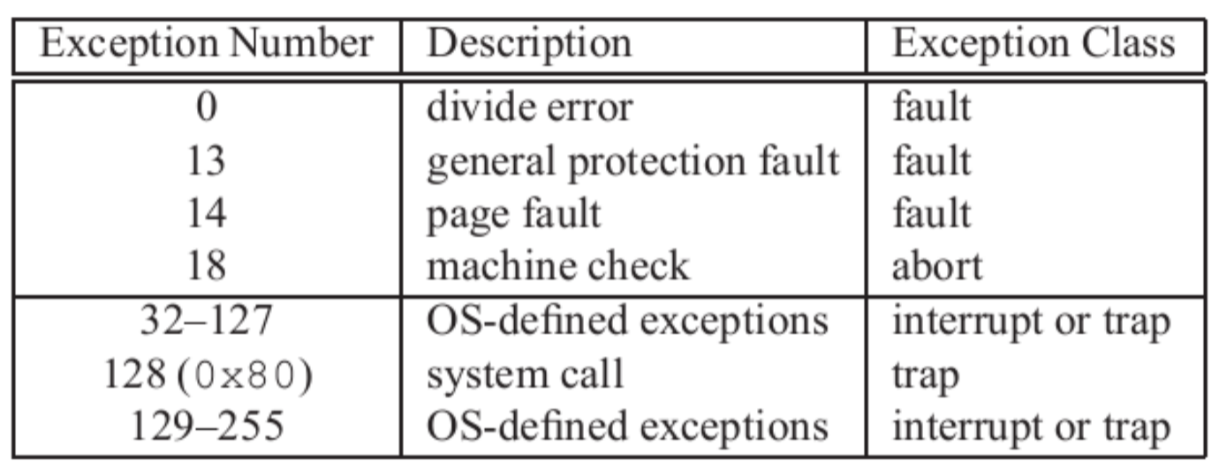
14.1.2 Exception in detail
How exception handler / ISR table is made?
CPU uses some
OS uses some
( BIOS in IA32 uses some )

Slide 23
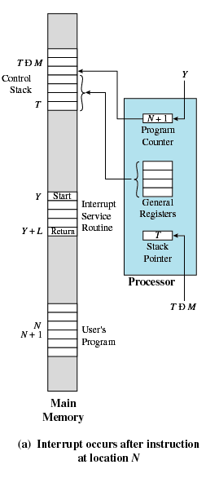
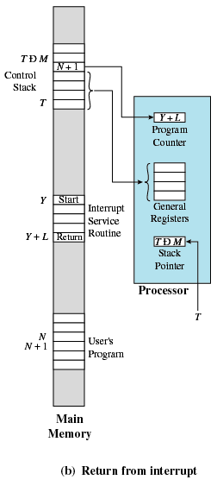
14.1.2 Exception in detail
How to switch to and return from exception handler/ISR?

Slide 24
14.1.2 Exception in detail
What exception handler/ISR returns?
Returns control to I_current
Returns control to I_next
Aborts the interrupted program, no return

Slide 25
14.1 Exception
14.1.1 Exception introduction
14.1.2 Exception in detail
14.1.3 Exception summary
14.1.4 Exception types
14.1.5 Exception in IA32/x86

Slide 26
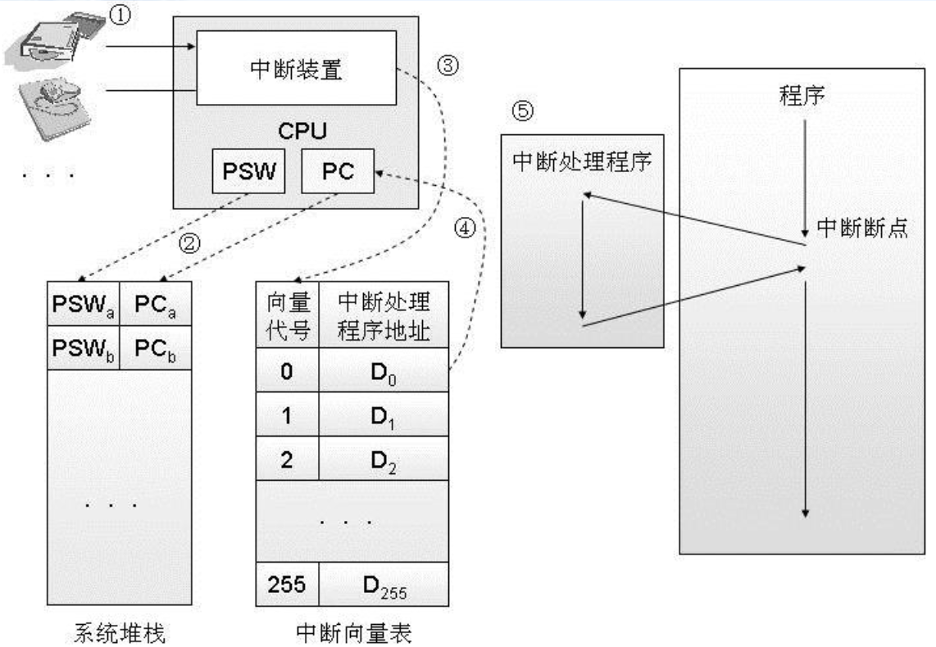
14.1.3 Exception summary

Slide 27
14.1.3 Exception summary
Exception V.S. Function calls
The return address
probably not the next instruction
Kernel stack V.S. user stack
Run in kernel mode
Push more onto the stack
EFLAGS (program status and control)
When occurs?
Relationship successive functions?
Hardware or software?

Slide 28
14.1 Exception
14.1.1 Exception introduction
14.1.2 Exception in detail
14.1.3 Exception summary
14.1.4 Exception types
14.1.5 Exception in IA32/x86

Slide 29
14.1.4 Exception types

Slide 30
14.1.4 Exception types
Asynchronous exceptions 异步异常
Interrupts 中断
E.g. Timer interrupt
E.g. I/O interrupt
Arrival of data from disk / network

Slide 31
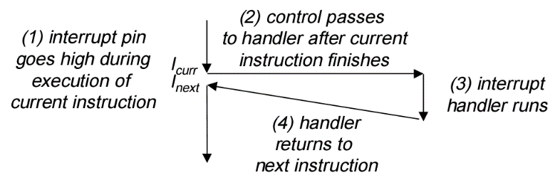
14.1.4 Exception types
Asynchronous exceptions 异步异常

Slide 32
14.1.4 Exception types
Synchronous exception 同步异常
Caused by events that occur as a result of executing an instruction
Traps 陷阱
E.g. system calls, breakpoint traps

Slide 33
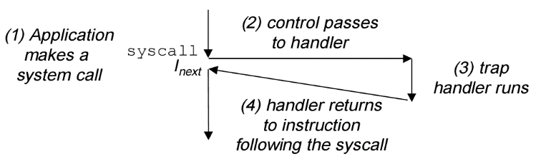
14.1.4 Exception types
Synchronous exception 同步异常
Traps 陷阱

Slide 34
14.1.4 Exception types
Synchronous exception 同步异常
Caused by events that occur as a result of executing an instruction
Faults 故障
E.g. page faults, protection faults, floating point exceptions

Slide 35
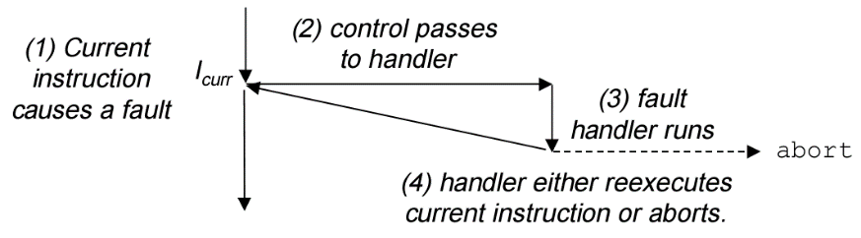
14.1.4 Exception types
Synchronous exception 同步异常
Faults 故障

Slide 36
14.1.4 Exception types
Synchronous exception 同步异常
Caused by events that occur as a result of executing an instruction
Aborts 终止
E.g. illegal instruction, ECC memory check

Slide 37
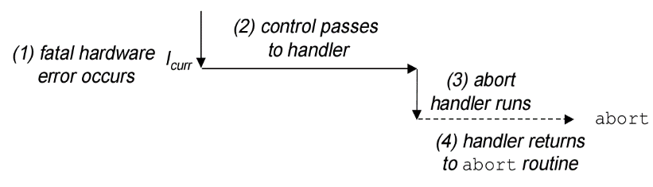
14.1.4 Exception types
Synchronous exception 同步异常
Aborts 终止

Slide 38
14.1 Exception
14.1.1 Exception introduction
14.1.2 Exception in detail
14.1.3 Exception summary
14.1.4 Exception types
14.1.5 Exception in IA32/x86

Slide 39
14.1.5 Exception in IA32/x86
Exception defined in Intel Pentium system
0-31 Pentium architecture
32-255 OS

Slide 40
Exception and Process/Thread
14.0 Flow of control
14.1 Exception
14.2 Process and Thread
14.3 Windows Process and Thread

Slide 41
14.2 Process and Thread
14.2.1 Process
14.2.2 Process related API for Win32
14.2.3 Thread

Slide 42
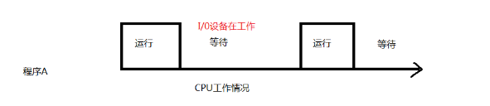
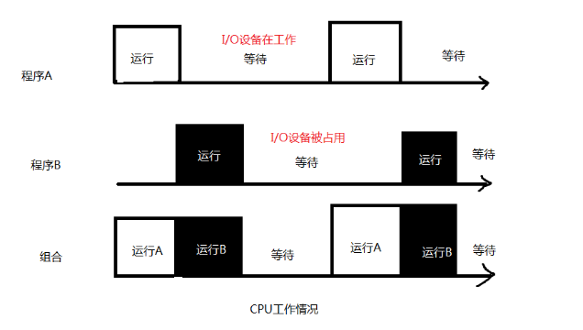
14.2.1 Process
Exceptions provide the basic building blocks that allow the operating system to provide the notion of a process

Slide 43
14.2.1 Process
Why?
Because OS can get control of CPU back by exception handler/ISR
Time slice is up
I/O finished
Call system call functions that may cause block
…

Slide 44
14.2.1 Process
What is a process: instance of a running program
How it is created by loader?
What is its relationship with program?
What it is made of?
DATA
CODE
CONTEXT/PCB
Apply for PCB
Allocate memory
Initialize PCB
Put into ready queue

Slide 45
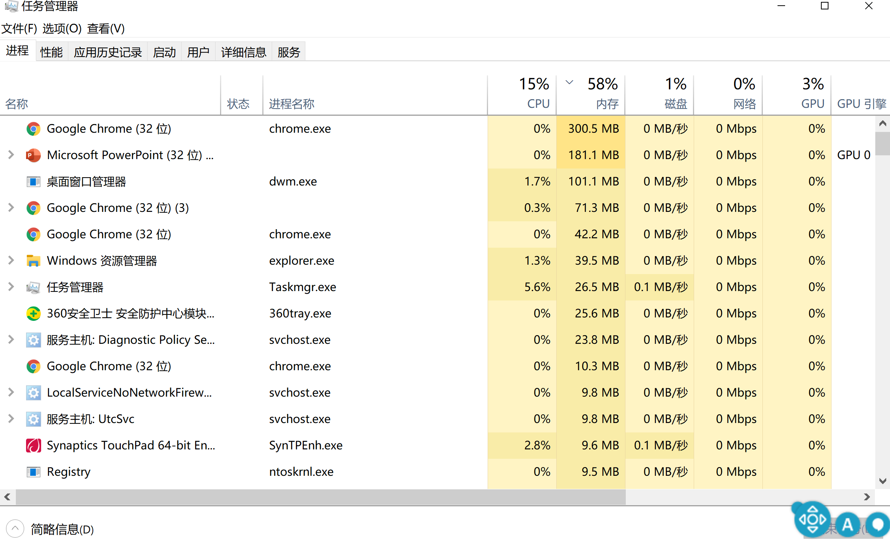
14.2.1 Process

Slide 46
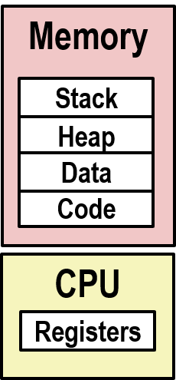
14.2.1 Process
Characteristics (key abstractions) of a process
Resource ownership (space)
Private address space
Virtual memory
Exclusive use of main memory
Scheduling/execution (time)
Logical control flow
Context switching
Exclusive use of the CPU

Slide 47
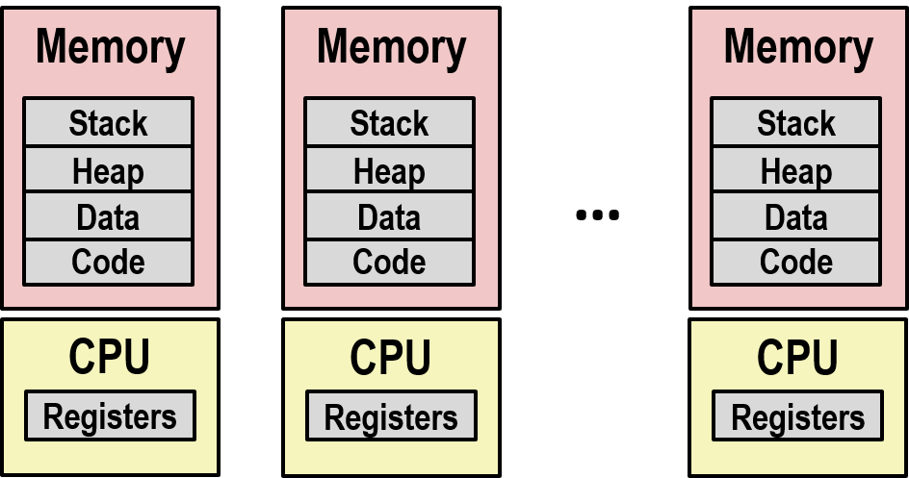
14.2.1 Process
Illusion 1: Logical control flow
Interleaving and concurrency 交错和并发
Logical and physical

Slide 48
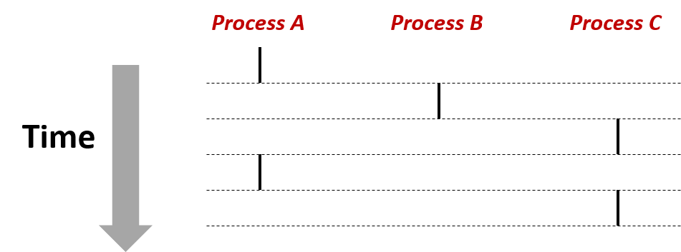
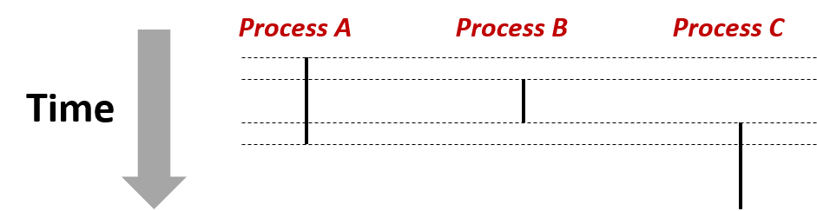
14.2.1 Process
Illusion 1: Logical control flow
Interleaving and concurrency 交错和并发
Logical and physical
Concurrent: AB, AC

Slide 49
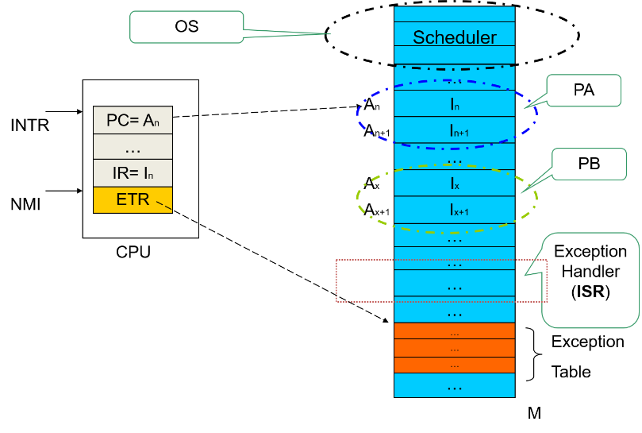
14.2.1 Process
Illusion 1: Logical control flow

Slide 50
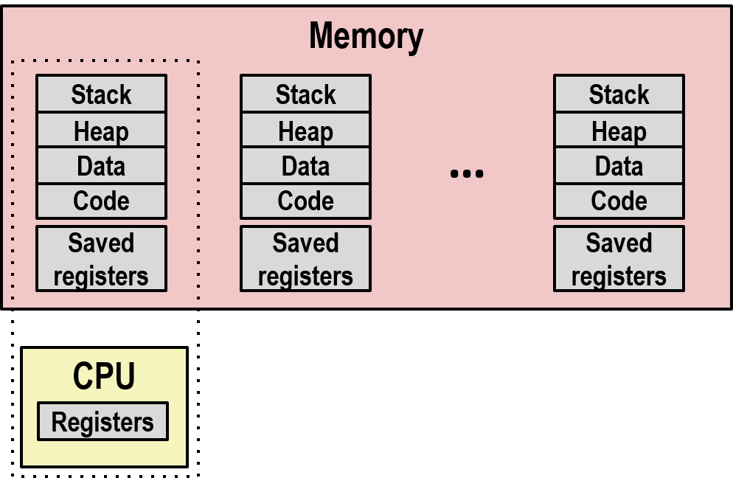
14.2.1 Process
Types of multitasking
Cooperative multitasking 协作式多任务
Preemptive multitasking 抢占式多任务
Scheduling - Deciding which process to run next

Slide 51
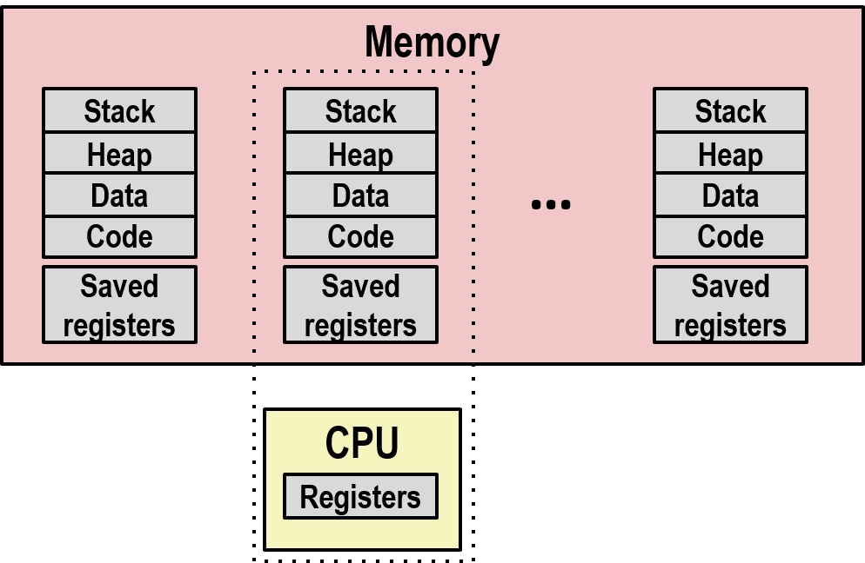
14.2.1 Process
Types of multitasking
Cooperative multitasking 协作式多任务
Preemptive multitasking 抢占式多任务
Scheduling - Deciding which process to run next

Slide 52
14.2.1 Process
Illusion 2: Private address space
A process provides each program with the illusion that it has exclusive use of the system’s address space

Slide 53
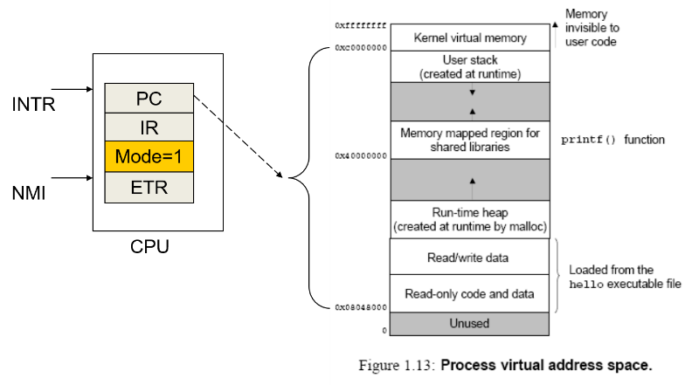
14.2.1 Process
Related terms
CPU mode
CPU mode = 1
用户态，不能执行特权指令

Slide 54

14.2.1 Process
Related terms
CPU mode
CPU mode = 0
系统态，能执行特权指令

Slide 55
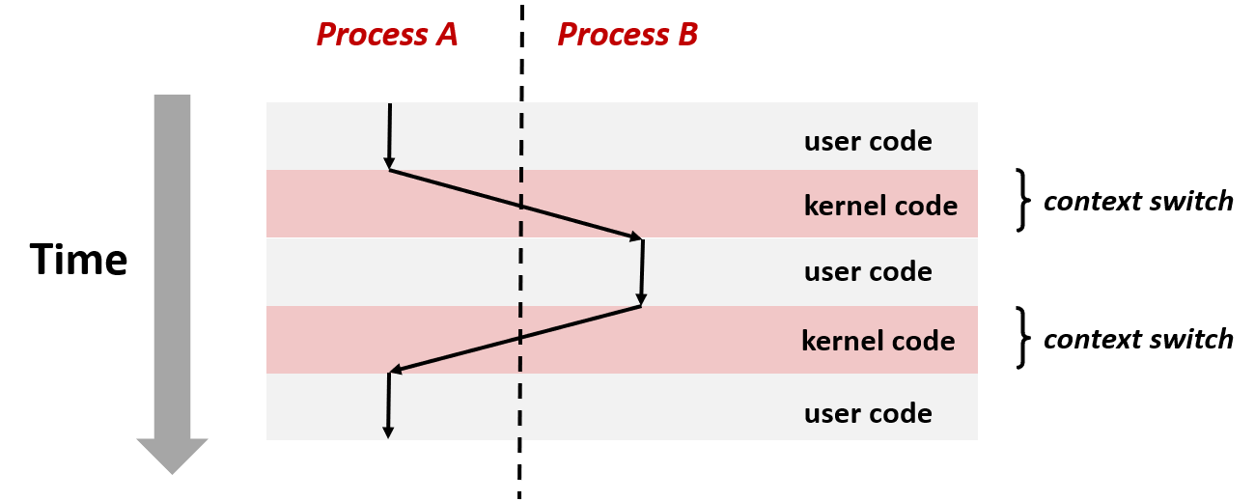
14.2.1 Process
Related terms summary
Mode switch
Context switch
Switch when exception happens
Read ->
Disk
interrupt ->
Return from read ->

Slide 56
14.2 Process and Thread
14.2.1 Process
14.2.2 Process related API for Win32
14.2.3 Thread

Slide 57
14.2.2 Process related API for Win32
Process creation
CreateProcess(): create a new process and its primary thread
Warp NtCreateProcessEx(), NtCreateThread() system calls
BOOL CreateProcess( LPCTSTR lpApplicationName, // 执行程序文件名 LPTSTR lpCommandLine, // 参数行 LPSECURITY_ATTRIBUTES lpProcessAttributes, // 进程安全参数 LPSECURITY_ATTRIBUTES lpThreadAttributes, // 线程安全参数 BOOL bInheritHandles, // 继承标记 DWORD dwCreationFlags, // 创建标记 LPVOID lpEnvironment, // 环境变量 LPCTSTR lpCurrentDirectory, // 运行该子进程的初始目录 LPSTARTUPINFO lpStartupInfo, // 创建该子进程的相关参数 LPPROCESS_INFORMATION lpProcessInformation // 创建后用于被创建子进程的信息 );

Slide 58
14.2.2 Process related API for Win32
Process termination
Main thread entry point function return
The thread call ExitProcess()
Thread in another process TerminateProcess()
Warp NtTerminateProcess() system call
All threads within the process terminate
BOOL TerminateProcess(
HANDLE hProcess, // handle to the process
UINT uExitCode // exit code for the process
);

Slide 59
14.2 Process and Thread
14.2.1 Process
14.2.2 Process related API for Win32
14.2.3 Thread

Slide 60

14.2.3 Thread
Why thread?
More flow of control / Trace in process

Slide 61
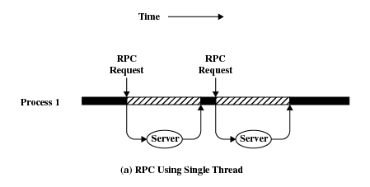
14.2.3 Thread
Why thread?
More flow of control / Trace in process
Romote Procedure Call (RPC)

Slide 62
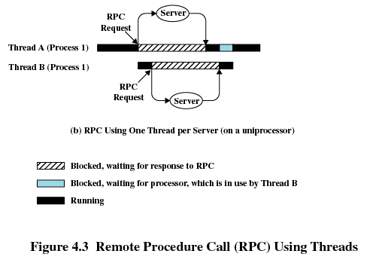
14.2.3 Thread
Why thread?
More flow of control / Trace in process

Slide 63
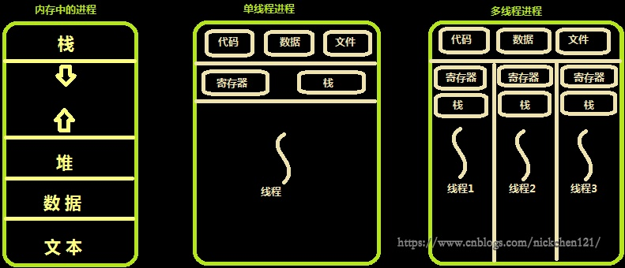
14.2.3 Thread
Multithreading refers to
the ability of an OS to support multiple threads of execution within a single process

Slide 64
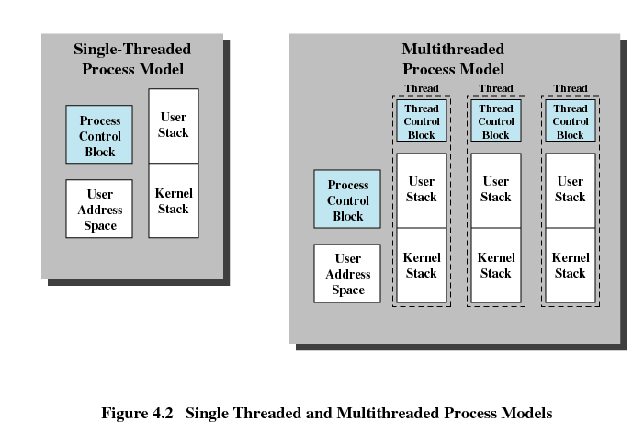
14.2.3 Thread
Multithreading

Slide 65
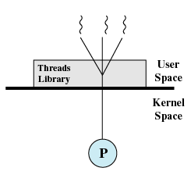
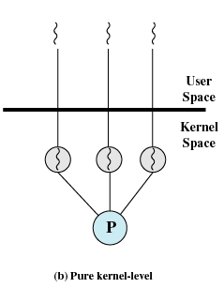
14.2.3 Thread
How – user level thread V.S. kernel level thread
ULT: Linux KLT: Windows

Slide 66
Exception and Process/Thread
14.0 Flow of control
14.1 Exception
14.2 Process and Thread
14.3 Windows Process and Thread

Slide 67
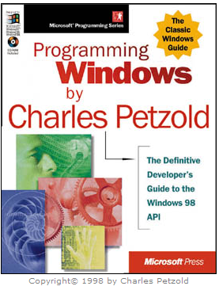
14.3 Windows Process and Thread
Charles Petzold – Programming windows 5th
Chapter 3: Windows and Messages
C and native APIs

Slide 68
14.3 Windows Process and Thread
14.3.1 Intro
14.3.2 Helloworld1 App—simple version
14.3.3 Helloworld2 App—full version
14.3.4 Summary
14.3.5 Windows Process
14.3.6 Windows Thread

Slide 69
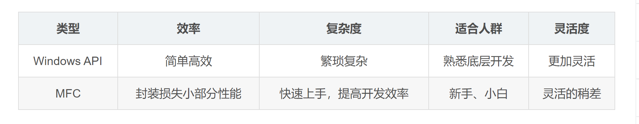
14.3.1 Intro
Why learn windows programming this way?
This approach offers you the best performance, the most power, and the greatest versatility/灵活性 in exploiting the features of Windows.
Executables are relatively small and don‘t require external libraries to run.
Most importantly, becoming familiar with the API provides you with a deeper understanding of Windows internals, regardless of how you eventually write applications for Windows.

Slide 70
14.3 Windows Process and Thread
14.3.1 Intro
14.3.2 Helloworld1 App—simple version
14.3.3 Helloworld2 App—full version
14.3.4 Summary
14.3.5 Windows Process
14.3.6 Windows Thread

Slide 71
14.3.2 Helloworld1 App—simple version
#include <windows.h>
int WINAPI WinMain (HINSTANCE hInstance, HINSTANCE hPrevInstance, PSTR szCmdLine, int iCmdShow)
{
MessageBox (NULL, TEXT ("Hello, world!"), TEXT ("HelloMsg"), 0) ;
return 0 ;
}

Slide 72
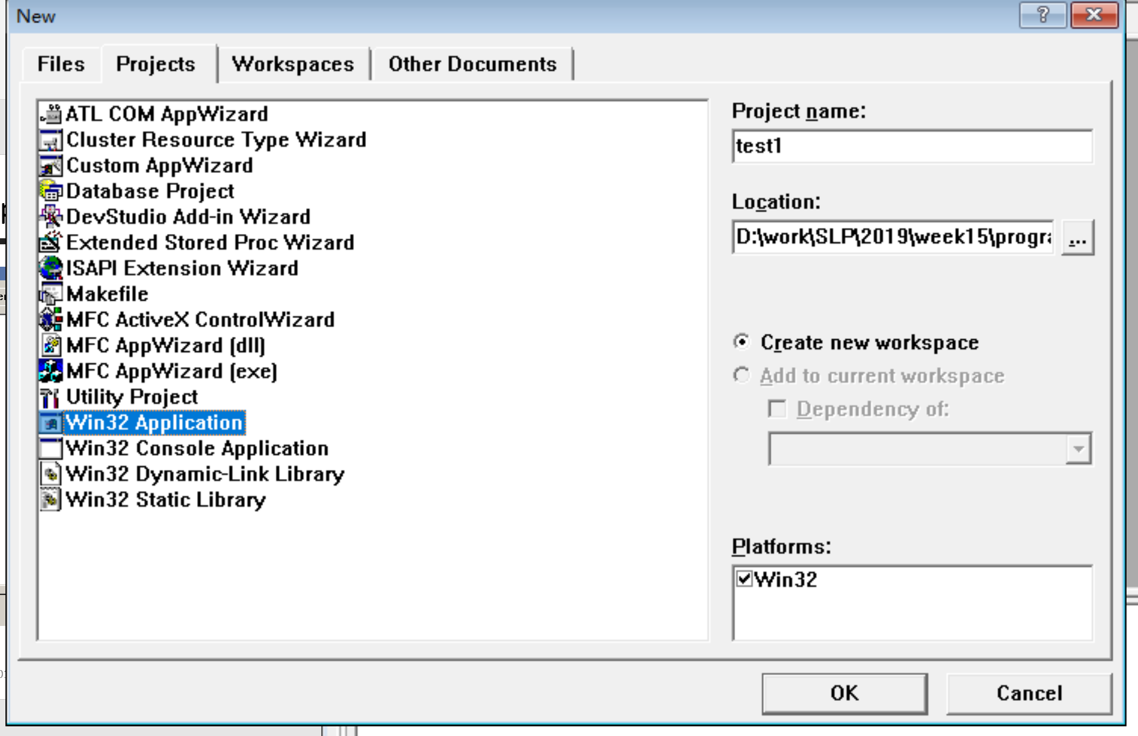
14.3.2 Helloworld1 App—simple version

Slide 73
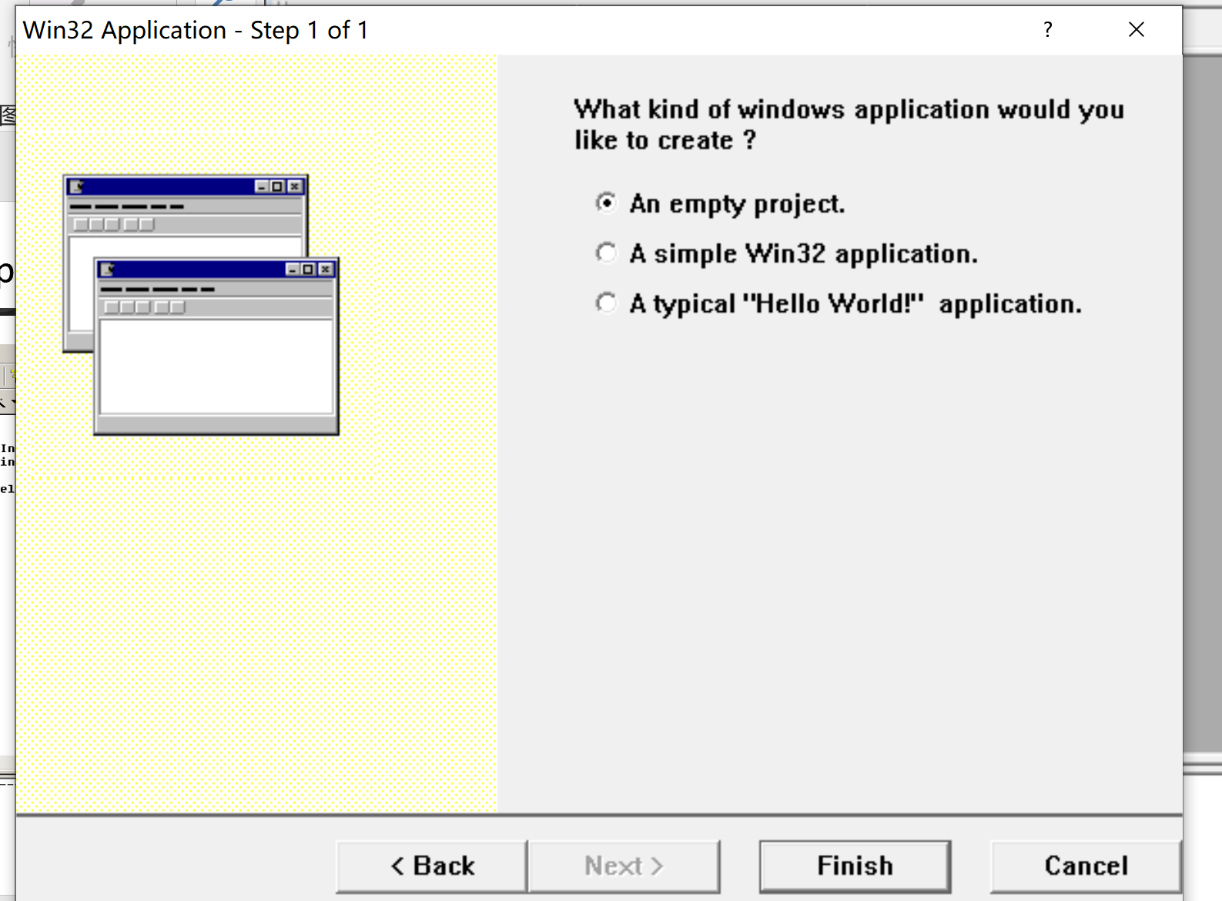
14.3.2 Helloworld1 App—simple version

Slide 74
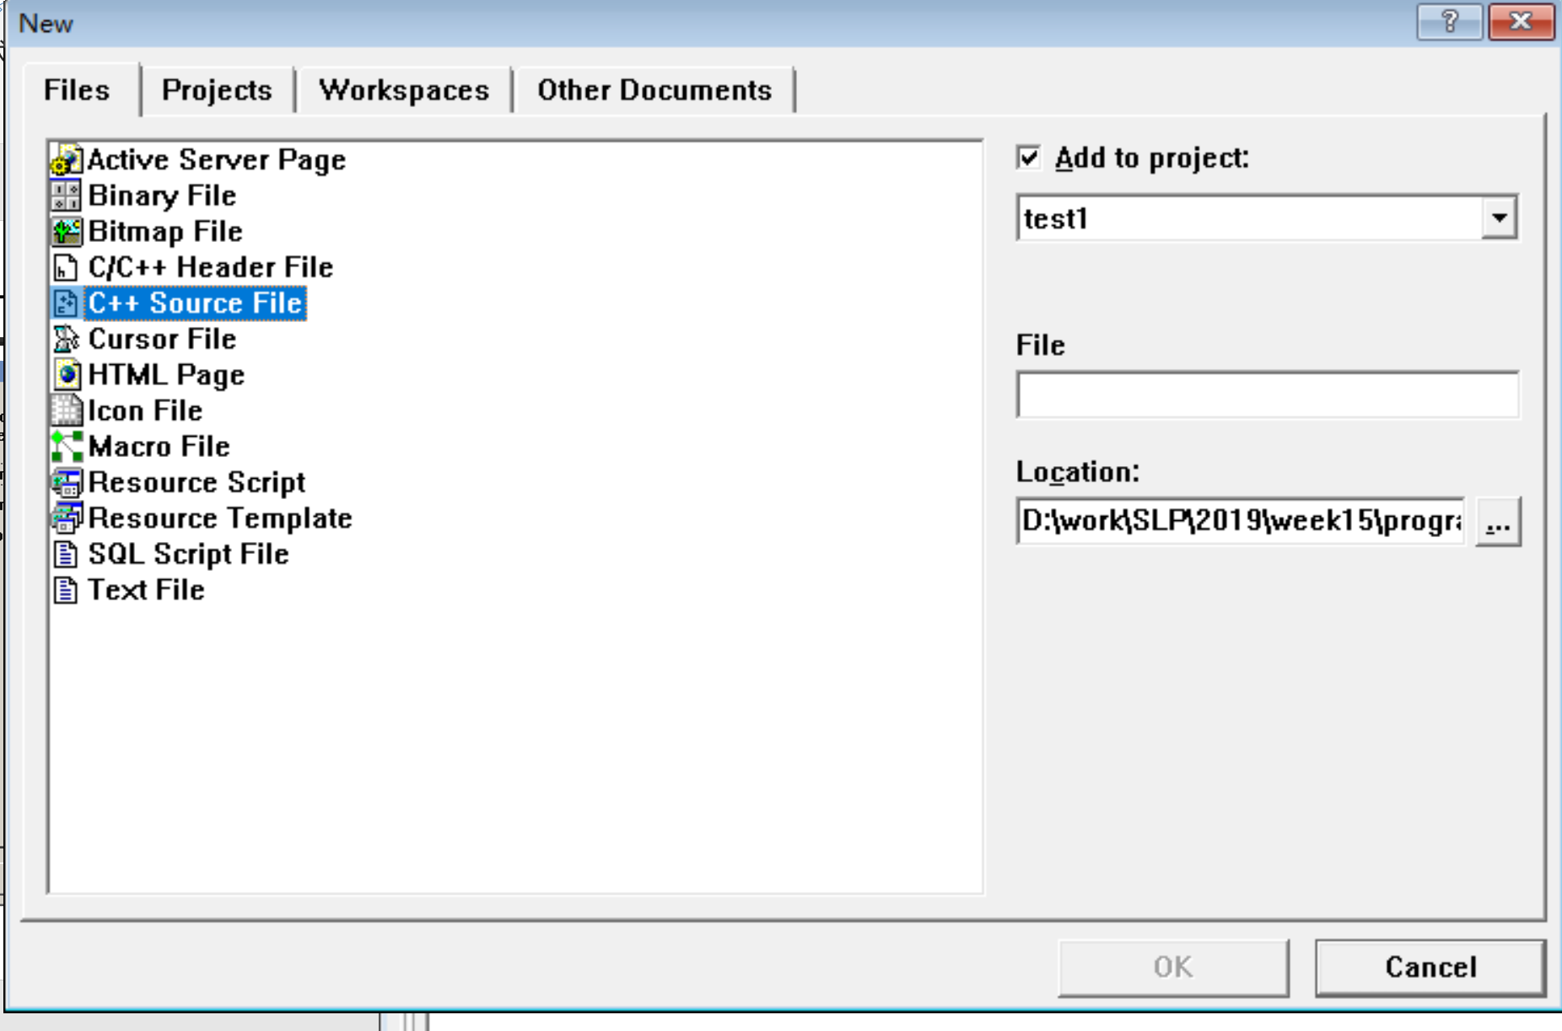
14.3.2 Helloworld1 App—simple version

Slide 75
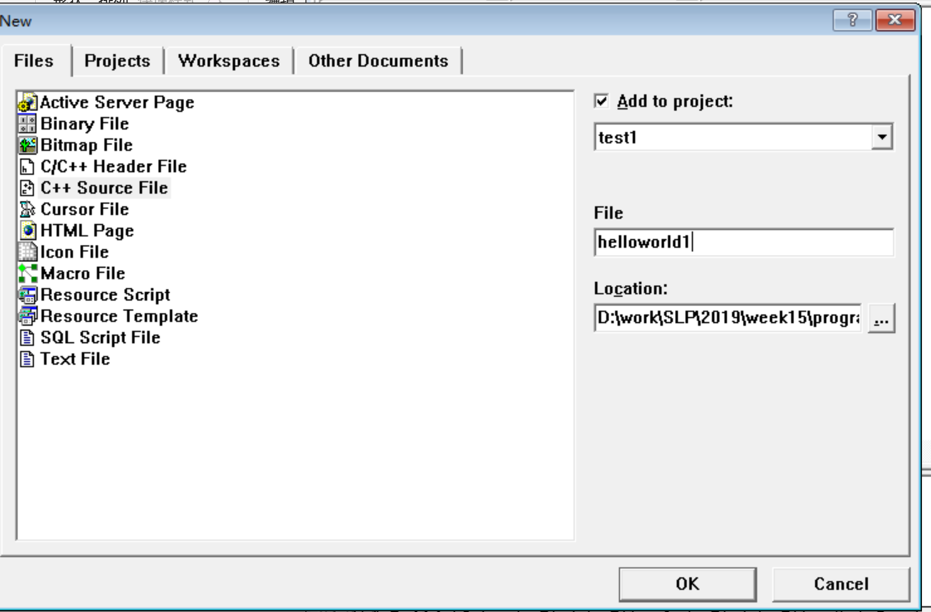
14.3.2 Helloworld1 App—simple version

Slide 76
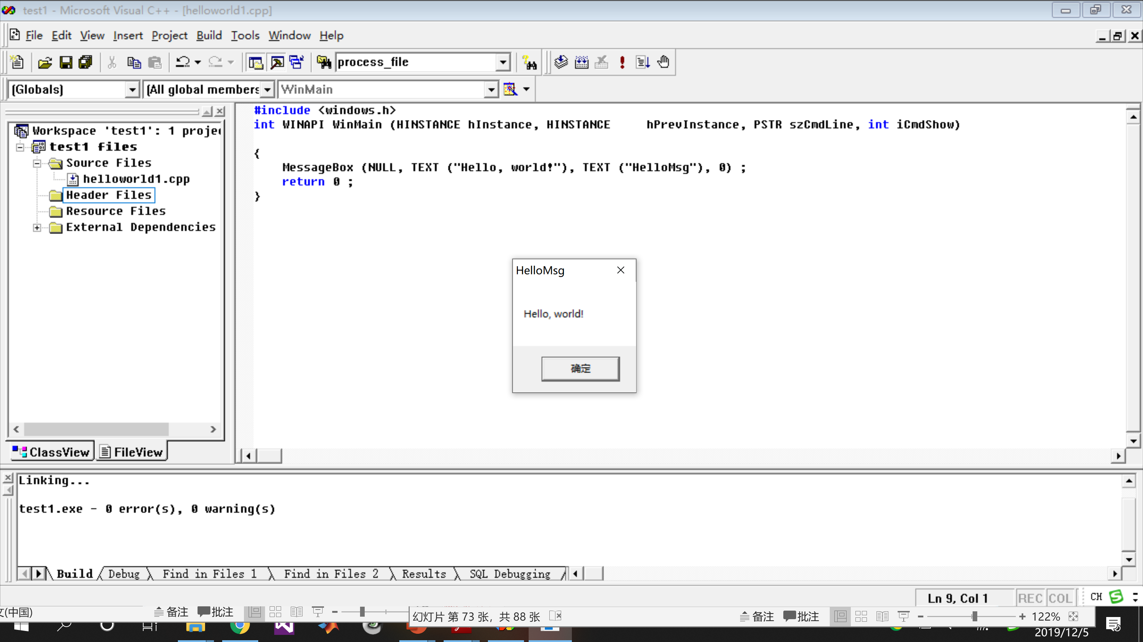
14.3.2 Helloworld1 App—simple version

Slide 77
14.3.2 Helloworld1 App—simple version
Notes
Header file WINDOWS.H
Program entry WinMain
#define WINAPI __stdcall function call protocol
hInstance instance handler 实例句柄
szCmdLine parameters
iCmdShow initialized window size
#include <windows.h>
int WINAPI WinMain (HINSTANCE hInstance, HINSTANCE hPrevInstance, PSTR szCmdLine, int iCmdShow) {
MessageBox (NULL, TEXT ("Hello, world!"), TEXT ("HelloMsg"), 0) ;
return 0 ;
}

Slide 78
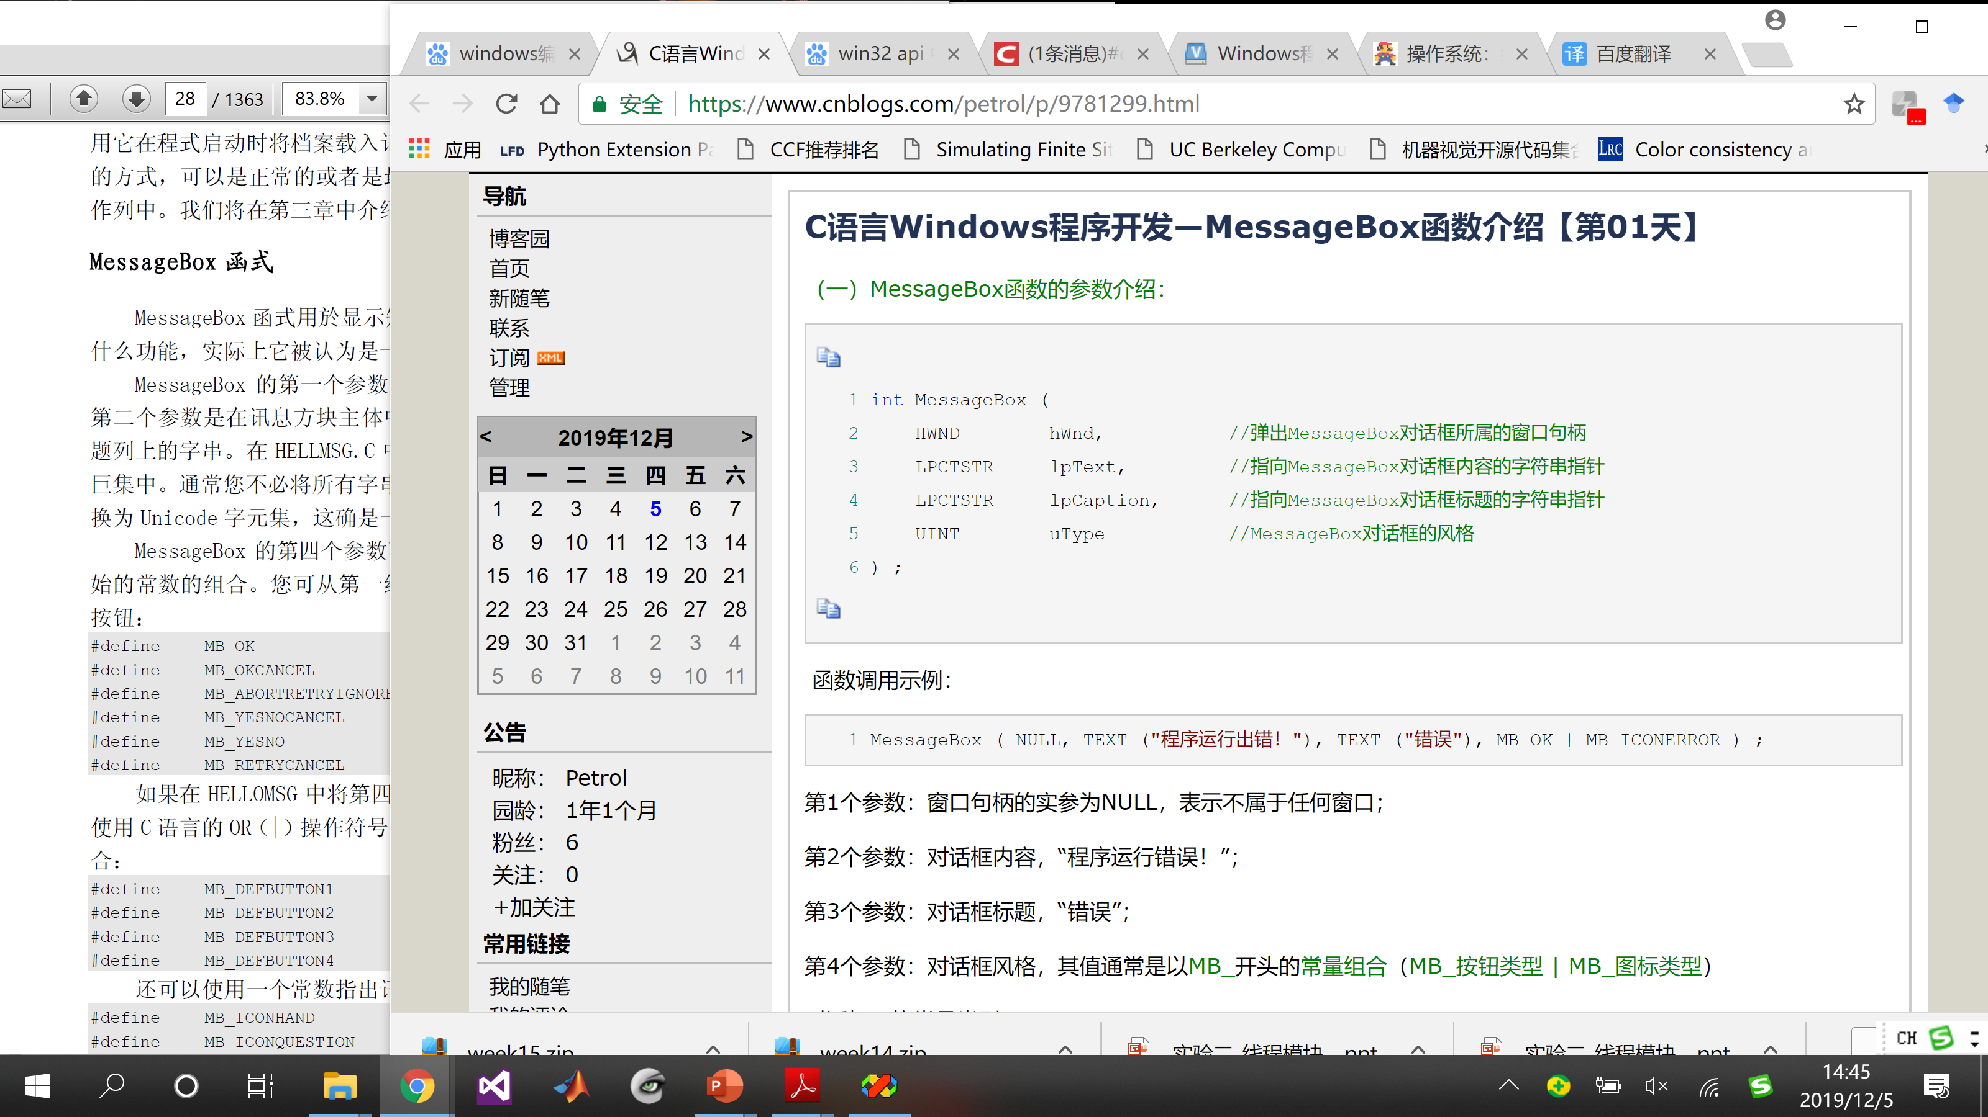
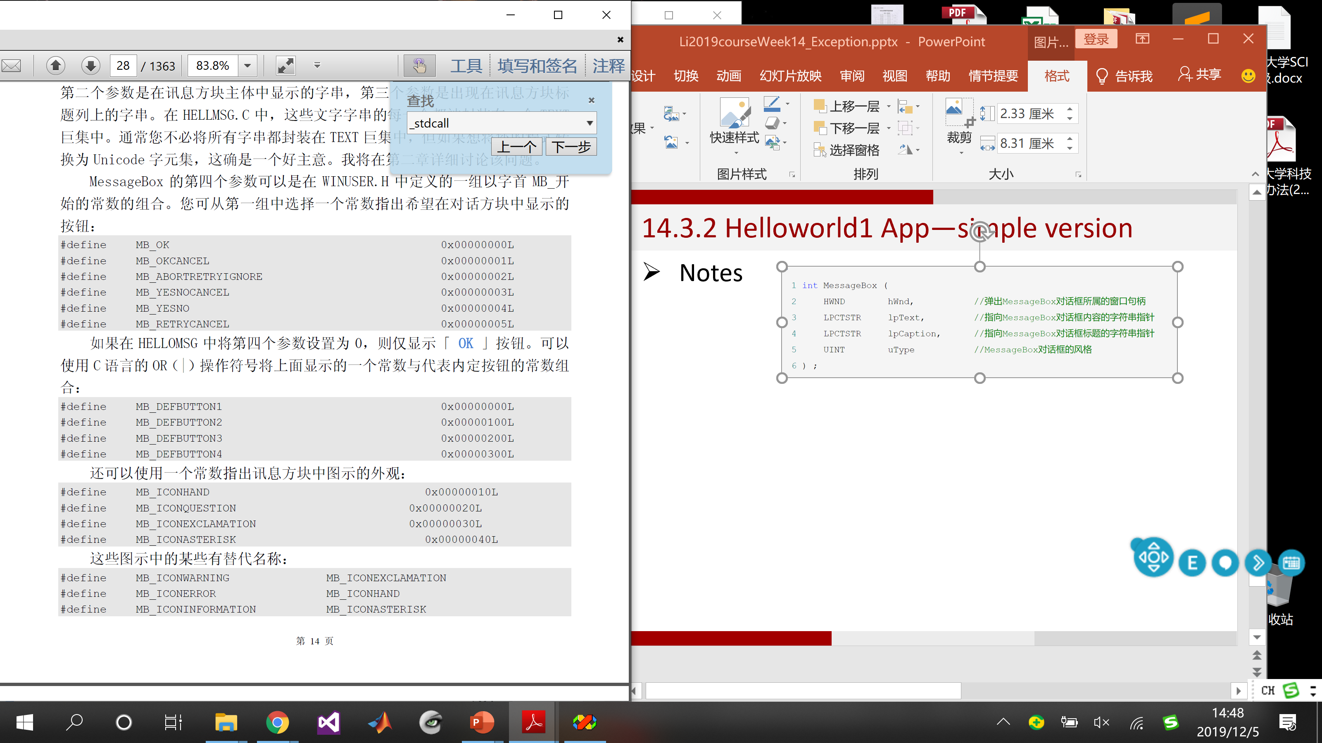
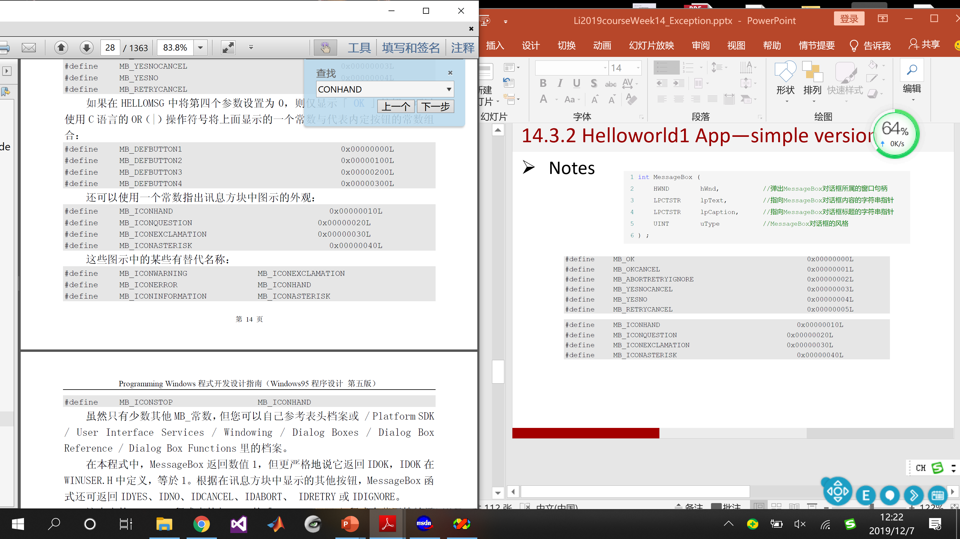
14.3.2 Helloworld1 App—simple version
Notes
Button
Icon appearance

Slide 79
14.3 Windows Process and Thread
14.3.1 Intro
14.3.2 Helloworld1 App—simple version
14.3.3 Helloworld2 App—full version
14.3.4 Summary
14.3.5 Windows Process
14.3.6 Windows Thread

Slide 80
14.3.3 Helloworld2 App—full version
Key points
Windows sends a message to the program
How the window, window class, window procedure, message queue, message loop, and the window messages all fit together in the context of a real program
Nobody really memorizes all the syntax to write this overhead
Begin a new program by copying an existing program and making appropriate change

Slide 81
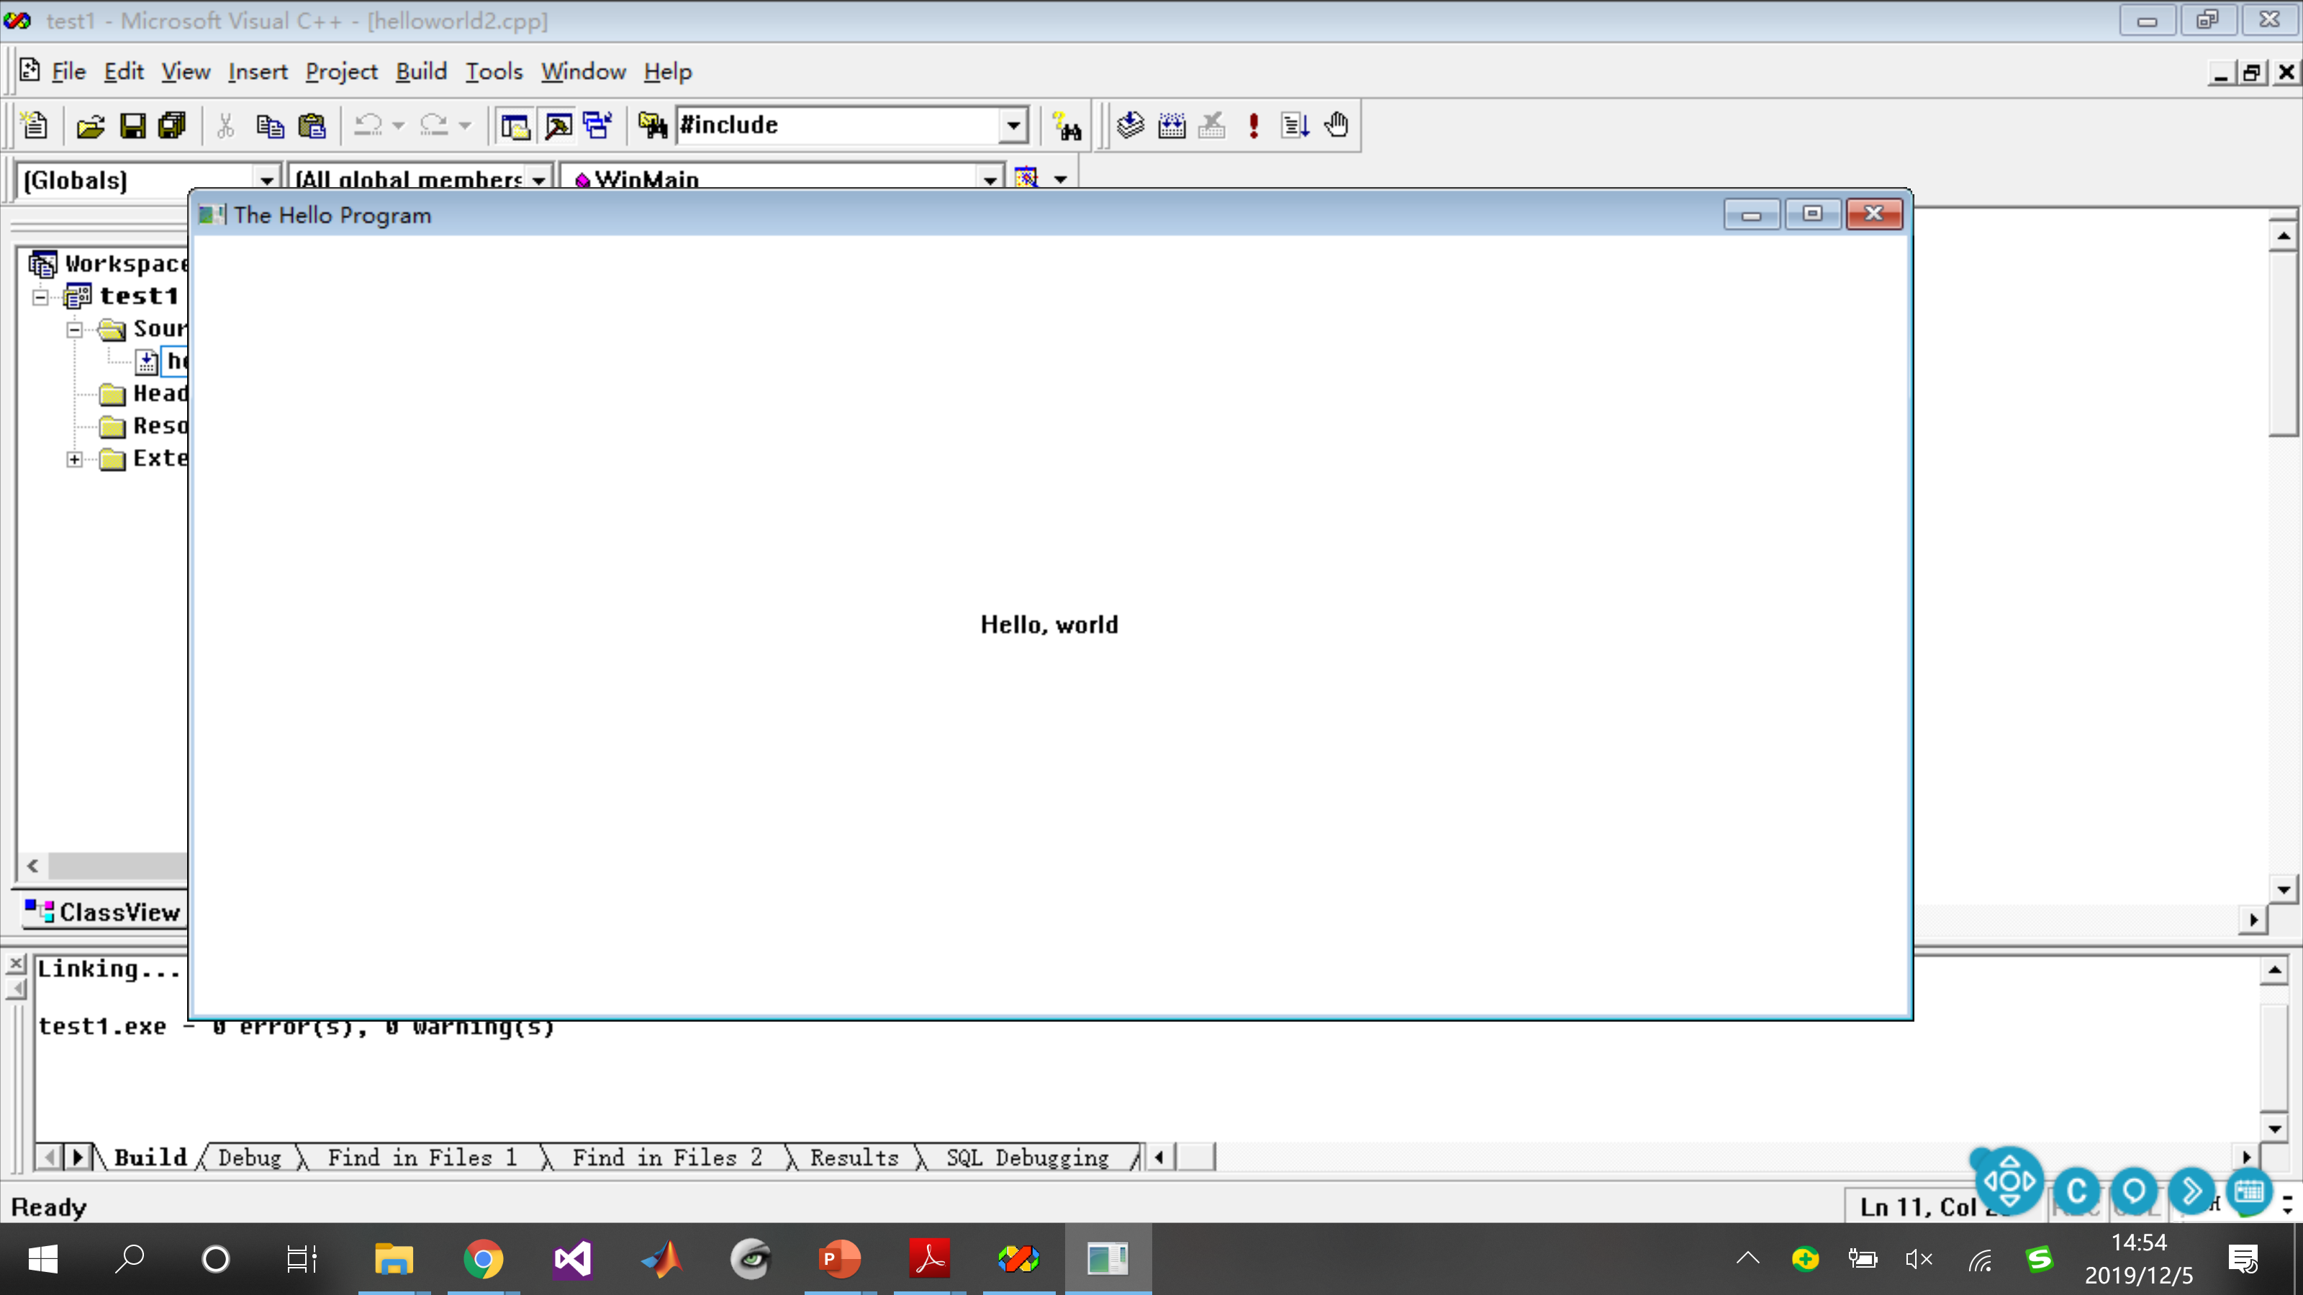
14.3.3 Helloworld2 App—full version

Slide 82
14.3.3 Helloworld2 App—full version
System calls
LoadIcon | Loads an icon for use by program
LoadCursor | Loads a mouse cursor for use by program
GetStockObject | Obtains a graphics object
RegisterClass | Registers a window class for the program’s window
MessageBox | Displays a message box
CreateWindow | Create a window based on a window class
ShowWindow | Shows the window on the screen
UpdateWindow | Directs the window to paint itself

Slide 83
14.3.3 Helloworld2 App—full version
System calls
GetMessage | Obtains a message from the message queue
TranslateMessage | Translates some keyboard messages
DispatchMessage | Sends a message to a window procedure
PlaySound | Plays a sound file
BeginPaint | Initiates the beginning of window painting
GetClientRect | Obtains the dimensions of the window’s client area
DrawText | Displays a text string
EndPaint | Ends window painting
PostQuitMessage | Inserts a ‘quit’ message into the message queue
DefWindowProc | Performs default processing of messages

Slide 84

14.3.3 Helloworld2 App—full version
Uppercase identifiers
CS | Class style | MB | Message box
CW | Create window | SND | Sound option
DT | Draw text | WM | Window message
IDI | ID number for icon | WS | Window style
IDC | ID number for cursor

Slide 85

14.3.3 Helloworld2 App—full version
New data types

Slide 86

14.3.3 Helloworld2 App—full version
New data types

Slide 87
14.3.3 Helloworld2 App—full version
Handles 句柄
Identifier | Meaning
HINSTANCE | Handle to an instance – program itself
HWND | Handle to a window
HDC | Handle to a device context
HICON | Handle to an icon
HCURSOR | Handle to a mouse cursor
HBRUSH | Handle to a graphics brush

Slide 88


14.3.3 Helloworld2 App—full version
Two functions

Slide 89



14.3.3 Helloworld2 App—full version
WinMain
Registering the windows class

Slide 90

14.3.3 Helloworld2 App—full version
WinMain
Creating the window
Displaying the window

Slide 91




14.3.3 Helloworld2 App—full version
WinMain
Message loop
Call WndProc
WM_QUIT

Slide 92

14.3.3 Helloworld2 App—full version
WinProc
Could be assigned with any name
Functionality – what is displayed and how the window responds to user input

Slide 93
14.3.3 Helloworld2 App—full version

Slide 94
14.3 Windows Process and Thread
14.3.1 Intro
14.3.2 Helloworld1 App—simple version
14.3.3 Helloworld2 App—full version
14.3.4 Summary
14.3.5 Windows Process
14.3.6 Windows Thread

Slide 95

14.3.4 Summary

Slide 96

14.3.4 Summary

Slide 97

14.3.4 Summary

Slide 98

14.3.4 Summary

Slide 99

14.3.4 Summary

Slide 100
14.3.4 Summary

Slide 101

14.3.4 Summary

Slide 102
14.3 Windows Process and Thread
14.3.1 Intro
14.3.2 Helloworld1 App—simple version
14.3.3 Helloworld2 App—full version
14.3.4 Summary
14.3.5 Windows Process
14.3.6 Windows Thread

Slide 103
14.3.5 Windows Process
System call function call related to process
Create
CreateProcess()
Finish
BOOL CreateProcess( LPCTSTR lpApplicationName, // 执行程序文件名 LPTSTR lpCommandLine, // 参数行 LPSECURITY_ATTRIBUTES lpProcessAttributes, // 进程安全参数 LPSECURITY_ATTRIBUTES lpThreadAttributes, // 线程安全参数 BOOL bInheritHandles, // 继承标记 DWORD dwCreationFlags, // 创建标记 LPVOID lpEnvironment, // 环境变量 LPCTSTR lpCurrentDirectory, // 运行该子进程的初始目录 LPSTARTUPINFO lpStartupInfo, // 创建该子进程的相关参数 LPPROCESS_INFORMATION lpProcessInformation // 创建后用于被创建子进程的信息 );

Slide 104
14.3.5 Windows Process
System call function call related to process
Create
Finish
ExitProcess()
TerminateProcess()
VOID ExitProcess(
UINT uExitCode // exit code for all threads
);
BOOL TerminateProcess(
HANDLE hProcess, // handle to the process
UINT uExitCode // exit code for the process
);

Slide 105
14.3 Windows Process and Thread
14.3.1 Intro
14.3.2 Helloworld1 App—simple version
14.3.3 Helloworld2 App—full version
14.3.4 Summary
14.3.5 Windows Process
14.3.6 Windows Thread

Slide 106

14.3.6 Windows Thread
Windows process is not schedulable
A container of threads
At least, there is a main thread in it
Creating threads
CreateThead()
System call
_beginthread()
Library function

Slide 107

14.3.6 Windows Thread

Slide 108
14.3.6 Windows Thread
Function CreateThread()
Return a handle of the thread if it is created
Otherwise return 0
HANDLE CreateThread(
PSECURITY_ATTRIBUTES psa,
DWORD cbStackSize,
PTHREAD_START_ROUTINE pfnStartAddr,
PVOID pvParam,
DWORD dwCreateFlags,
PDWORD pdwThreadID);

Slide 109
14.3.6 Windows Thread
Function CreateThread()
Size of the thread stack
HANDLE CreateThread(
PSECURITY_ATTRIBUTES psa,
DWORD cbStackSize,
PTHREAD_START_ROUTINE pfnStartAddr,
PVOID pvParam,
DWORD dwCreateFlags,
PDWORD pdwThreadID);
pointer to STRCUT (NULL for default)
Address of the thread function

Slide 110
14.3.6 Windows Thread
0 OR
CREATE_SUSPENDED
Function CreateThread()
HANDLE CreateThread(
PSECURITY_ATTRIBUTES psa,
DWORD cbStackSize,
PTHREAD_START_ROUTINE pfnStartAddr,
PVOID pvParam,
DWORD dwCreateFlags,
PDWORD pdwThreadID);
Arguments
ID of the thread we created

Slide 111
14.3.6 Windows Thread
Function _beginthread()
Used in C/C++
_beginthread() calls CreateThread()
_endthread() calls ExitThread()
unsigned long _beginthread(
void( __cdecl *start_address )( void * ),
unsigned stack_size,
void *arglist );

Slide 112
14.3.6 Windows Thread
Four methods to terminate a thread
VOID ExitThread(DWORD dwExitCode)
BOOL TerminateThread(HANDLE hThread, DWORD dwExitCode)
ExitProcess() or TerminateProcess()
Thread’s correct return We commend this way to terminate

